Slide 1
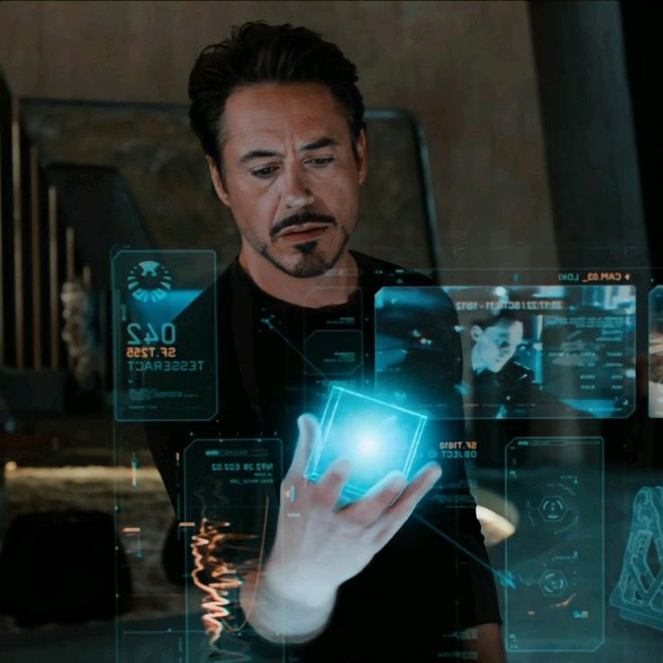
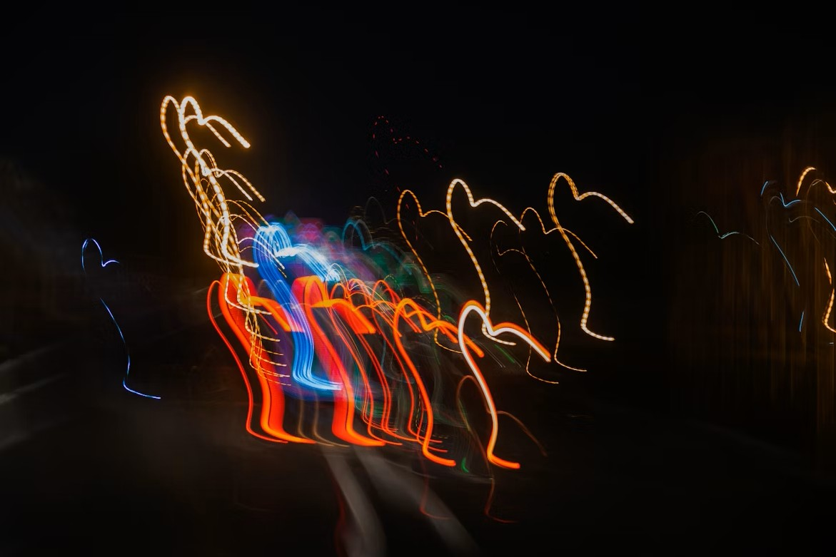
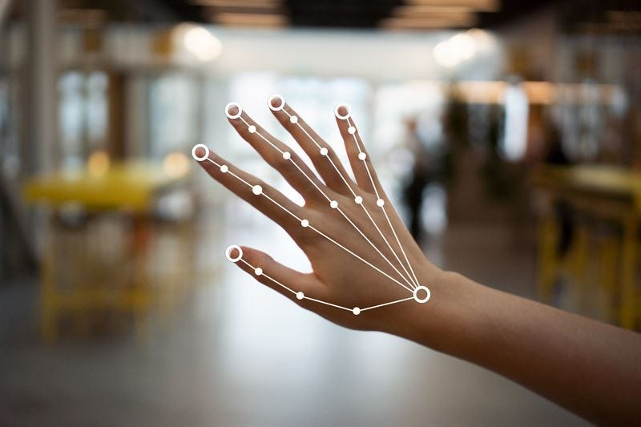
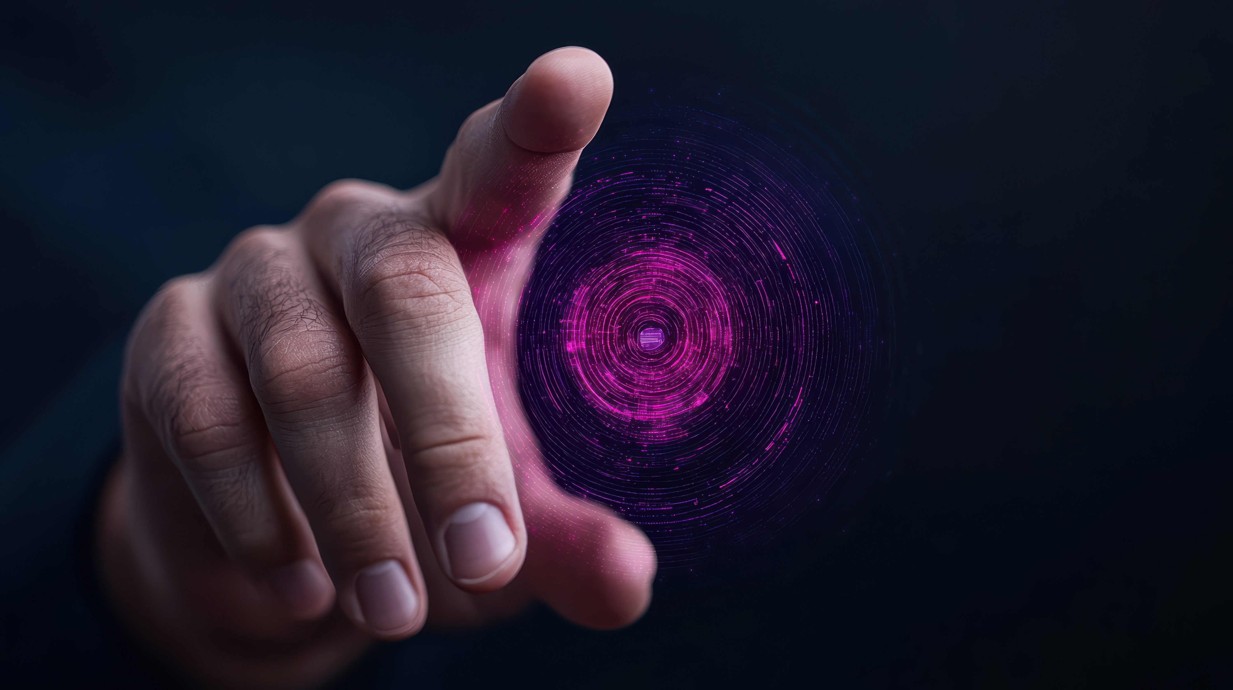
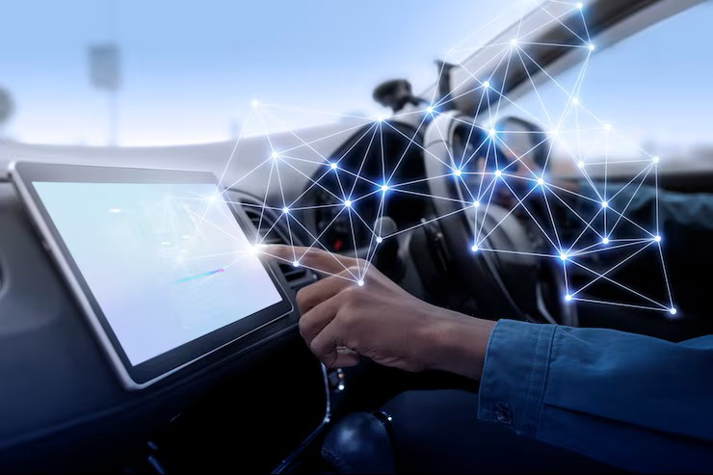

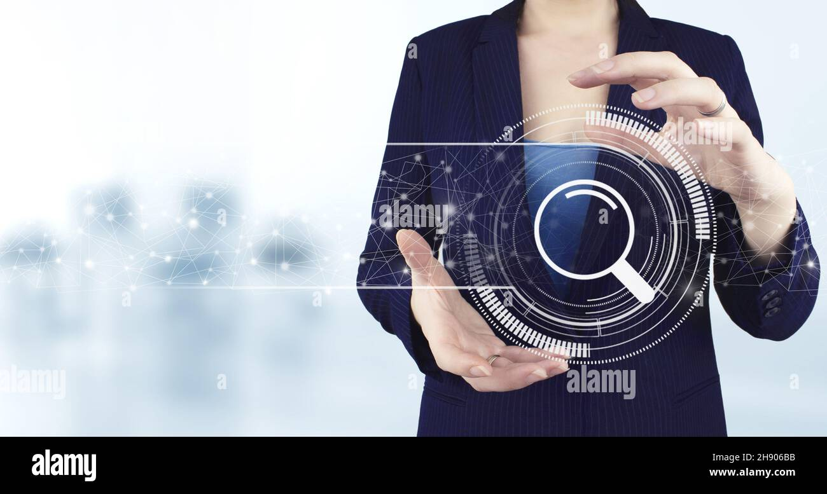
HOLOGRAPHIC
NAVIGATION

Slide 2

HaloNav-AI Air Navigation System
~ “Your Hands Are the New Mouse” ✋🖱
By
B Neeraj kumar
D Balaji
M Rajendra Naidu
G Sai Santhosh Reddy
HOLOGRAPHIC
NAVIGATION

Slide 3

Why Halo-Nav ?
“Millions of Indians still work on low-cost laptops with poor touchpads or broken mice. During COVID, touchless interaction became important for hygiene. We solve both problems with a camera-only solution”
With HoloNav, we remove the barriers of hardware. Now, every hand can control a computer — fast, hygienic, and futuristic.
HOLOGRAPHIC
NAVIGATION

Slide 4
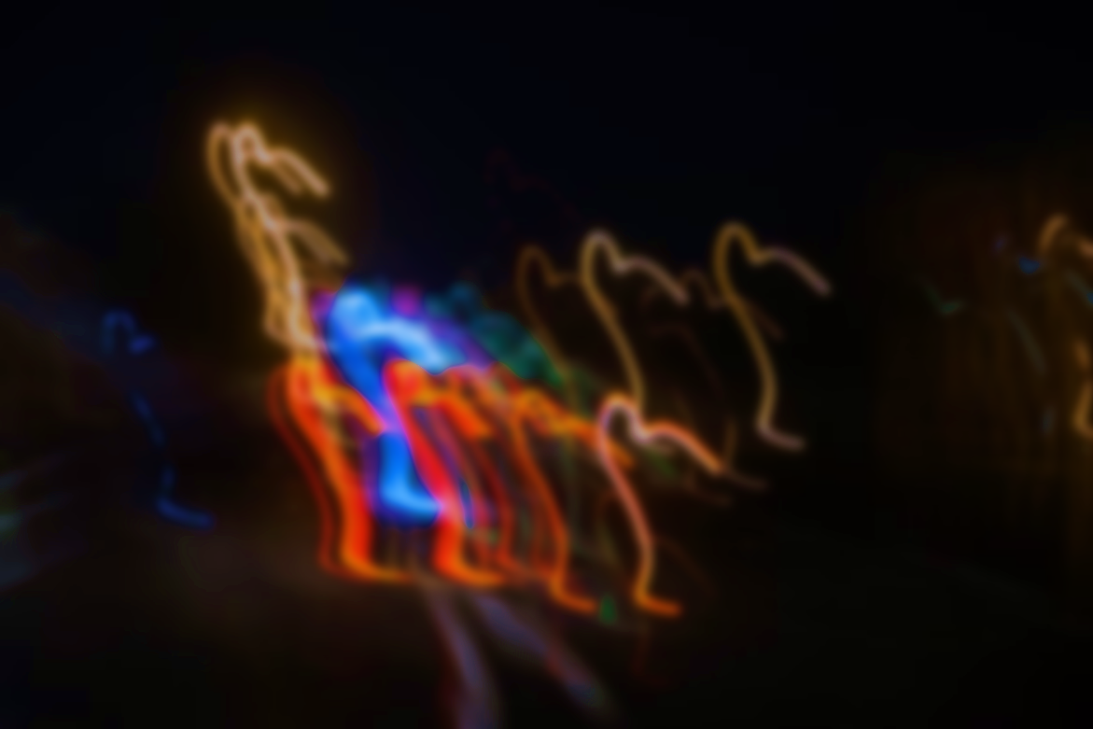
Technologies & Setup
Built using Python
Key libraries: Media Pipe,
OpenCV, PyAutoGUI, Pygame
Voice tools :Speech Recognition , PyAudio
Data handling : NumPy
Requirements: Python 3, webcam , optional Chrome & WhatsApp
HOLOGRAPHIC
NAVIGATION

Slide 5
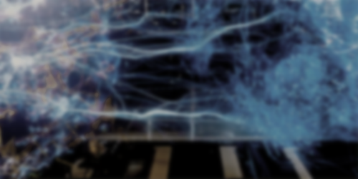
Gesture & Voice Control
Gesture recognition via Media Pipe + OpenCV
Hand landmarks mapped to specific actions
Voice commands processed with Speech Recognition
Speech converted to text and matched to predefined actions
HOLOGRAPHIC
NAVIGATION

Slide 6

HUD & Program Control
HUD built with Pygame
Displays system status, last command, and FPS
Starts by running main.py
Stops via HUD close, Ctrl+C, or saying “exit program”
HOLOGRAPHIC
NAVIGATION

Slide 7

Error Handling & App Control
HOLOGRAPHIC
NAVIGATION
Cooldown prevents repeated gesture actions
PyAutoGUI & subprocess used to open/close apps
Errors caught with try/except blocks
HUD updates with error messages for feedback

Slide 8

Modularity & Extensibility
HOLOGRAPHIC
NAVIGATION
Features split into separate files: gesture.py, voice.py, HUD, config
Easy to add new gestures or commands via dictionaries
Threads run gesture, voice, HUD independently
Virtual environment ensures clean dependency management

Slide 9

Real world Solutions with Halonav
HOLOGRAPHIC
NAVIGATION
Accessibility for Disabled Users
Touchless Computing in Public Spaces
Smart Classrooms & Presentations
Gaming & Entertainment
Industrial / Field Work
Hygienic in Hospitals

Slide 10
HOLOGRAPHIC
NAVIGATION
Thank You

